Slide 1




KIT-KALAIGNARKARUNANIDHI INSTITUTE OF TECHNOLOGY
COIMBATORE - 641402
Approved by AICTE Affiliated to Anna University, Chennai
Accredited With ‘A’ Grade by NAAC & By NBA
DEPARTMENT OF COMPUTER SCIENCE AND BUSINESS SYSTEMS
Low-Cost IoT-Based Elevator Safety Digital Twin for Realtime Monitoring &
Predictive Fault Detection
BATCH NO:16
TEAM MEMBERS
SUPERVISOR
Ms.U.PRIYA
Asst.Prof/CSBS
1.LEKHAMOL V (711524BCB029)
2.THULASI Y(711524BCB055)
3.SANJAY P (711524BCB047)

Slide 2
DOMAIN
Internet of Things (IoT)
Digital Twin Technology
Artificial Intelligence (AI)
Machine Learning (ML)
Predictive Maintenance
Real-Time Monitoring

Slide 3
OBJECTIVE
To develop a low-cost elevator safety monitoring prototype using IoT sensors.
To create a digital twin that represents the real-time condition of the physical elevator.
To monitor parameters such as vibration, temperature, floor position and door status.
To detect abnormal conditions and provide early fault warnings.
To explore lightweight AI-based anomaly detection for predictive maintenance.
To reduce manual inspection and improve elevator safety and maintenance efficiency.

Slide 4
ABSTRACT
Elevator safety is an important concern as mechanical and electrical faults can lead to operational failures and safety risks.
Conventional inspection methods mainly depend on periodic maintenance and manual observation, which may not identify developing faults at an early stage. This project proposes a low-cost IoT-based Elevator Safety Digital Twin that continuously monitors the physical elevator prototype using sensors.
An ESP32 collects parameters such as vibration, temperature, floor position and door status and transfers the data to a digital representation of the elevator.
The digital twin provides real-time visualization of elevator operating conditions and identifies abnormal behavior.
Fault simulation can be incorporated to test conditions such as excessive vibration, door obstruction and abnormal movement.

Slide 5
LITERATURE REVIEW
S.No | ARTICLE TITLE & PUBLICATION DETAIL | METHODOLOGY USED
1 | Elevator fault diagnosis based on digital twin and PINNs-e-RGCN — Scientific Reports, 2024 | Digital Twin, PINNs, e-RGCN, vibration modelling, fault diagnosis
2 | An IoT-Based Real-Time Elevator Health Monitoring System Using LSTM Autoencoder — IEEE Sensors Letters, 2026 | IoT, accelerometer, wireless communication, LSTM Autoencoder, anomaly detection

Slide 6
LITERATURE REVIEW….
S.No | ARTICLE TITLE & PUBLICATION DETAIL | METHODOLOGY USED
3 | Elevator Running Fault Monitoring Method Based on Vibration Signal — Shock and Vibration, 2021 | Vibration signals, wavelet transform, PCA, 1-D CNN, fault classification
4 | Non-contact Optical Vibration Sensing and Dual-Branch Deep Learning for Intelligent Elevator Fault Diagnosis — Sensors and Actuators A: Physical, 2026 | Optical vibration sensing, LSTM-CNN, deep learning, fault classification

Slide 7
LITERATURE REVIEW….
S.No | ARTICLE TITLE & PUBLICATION DETAIL | METHODOLOGY USED
5 | Digital Twin-Based Fault Diagnosis and Predictive Maintenance for Industrial Systems | Digital Twin, IoT sensors, real-time monitoring, predictive maintenance
6 | AI-Based Intelligent Condition Monitoring of Elevator Systems | Machine Learning, sensor data analysis, anomaly detection, condition monitoring

Slide 8
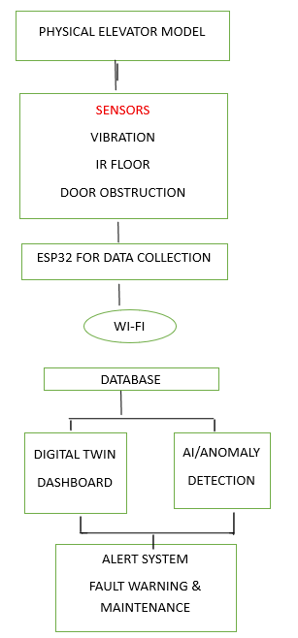
PROPOSED BLOCK DIAGRAM

Slide 9
DETAILS OF PROPOSED SYSTEM
Physical Elevator Prototype
A small-scale elevator model will be constructed using low-cost materials. A DC geared motor will control the movement of the elevator cabin between floors.
Sensor Module
Sensors will continuously collect elevator operating parameters:
Vibration sensor → detects abnormal vibration
Temperature sensor → monitors overheating
IR sensor → detects floor position
IR obstacle sensor → detects door obstruction
Optional current sensor → monitors motor current

Slide 10
REFERENCES
S.NO | REFERENCE DETAILS
1 | Q. Wang, L. Chen, G. Xiao, P. Wang, Y. Gu, and J. Lu, “Elevator fault diagnosis based on digital twin and PINNs-e-RGCN,” Scientific Reports, vol. 14, Art. no. 30713, 2024, doi: 10.1038/s41598-024-78784-7.
2 | Y. Kumar, M. A. Khan, and A. Adhikary, “An IoT-Based Real-Time Elevator Health Monitoring System Using LSTM Autoencoder,” IEEE Sensors Letters, 2026.
3 | Elevator Running Fault Monitoring Method Based on Vibration Signal, Shock and Vibration, 2021.
4 | “Real-Time Intelligent Elevator Monitoring and Diagnosis: Case Studies and Solutions with Applications Using Artificial Intelligence,” Computers & Electrical Engineering, 2022.
5 | J. Luo et al., “Non-contact optical vibration sensing and dual-branch deep learning for intelligent elevator fault diagnosis,” Sensors and Actuators A: Physical, 2026.
6 | Deep Learning Methods for Fault Early Warning of Elevator Traction Systems with Multi-Source Data Fusion — Discover Applied Sciences, Springer, 2026
7 | Deep Learning Methods for Fault Early Warning of Elevator Traction Systems with Multi-Source Data Fusion — Discover Applied Sciences, Springer, 2026

